Slide 1
Evaluating Machine Learning Models for Minimizing Downtime through Operator Task Scheduling in CNC Production Lines
Background
Related work
Methodology
Architecture
Optimization
Results
Conclusion
Student: Kaan Özsan Mail: ozsan@kth.se Organization: Scania
Date: 03-06-2025
Supervisor: Yasaman Khorsandmanesh Examiner: Håkan Olsson
Architecture
Evaluation

Slide 2
Background
Research Question
Which machine learning models perform best in predicting and scheduling operator tasks in a CNC production line environment, based on metrics such as accuracy, precision, latency, and robustness?
Sub-questions include:
How do different models compare in handling real-time or simulated data for predictive task planning?
Which model performs best at classifying operator task occurrences relevant to operator scheduling?
Which machine learning approach, in the context of continuous learning, results in the least downtime during model updates and retraining?

Slide 3
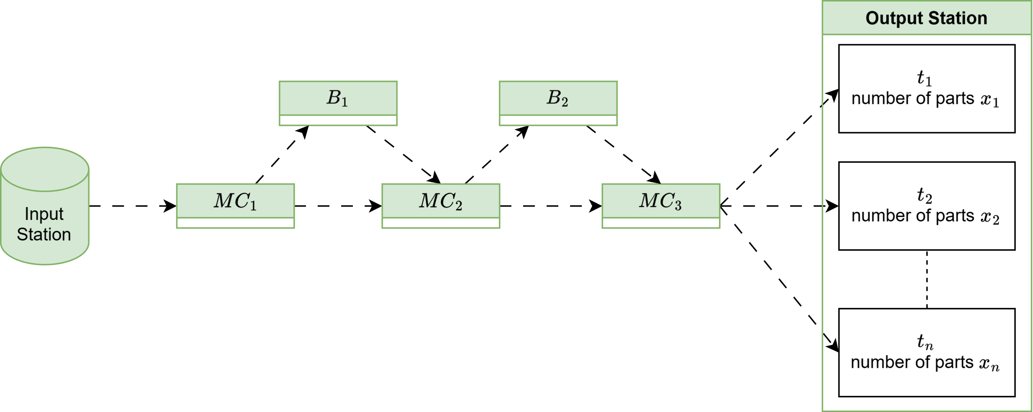
Background
CNC lines produce parts using machines that require periodic operator-performed maintenance.
Common tasks include tool changes and quality checks, which may affect line throughput.
Task timing may shift if machine dependencies cause production to pause (e.g., due to upstream/downstream stoppages).
Overlapping tasks (e.g., multiple tool changes at once) increase operator load and response time.

Slide 4
Related work
No prior studies target operator task prediction in CNC environments.
Smart maintenance research applies ML to forecast tool wear and failures.
Techniques include time-series models and event-driven forecasting.
This thesis adapts those methods to model operator-dependent interventions.
Notes:
there are several studies on timeseries forecasting and smart maintanance but jus specific this task there are non.

Slide 5
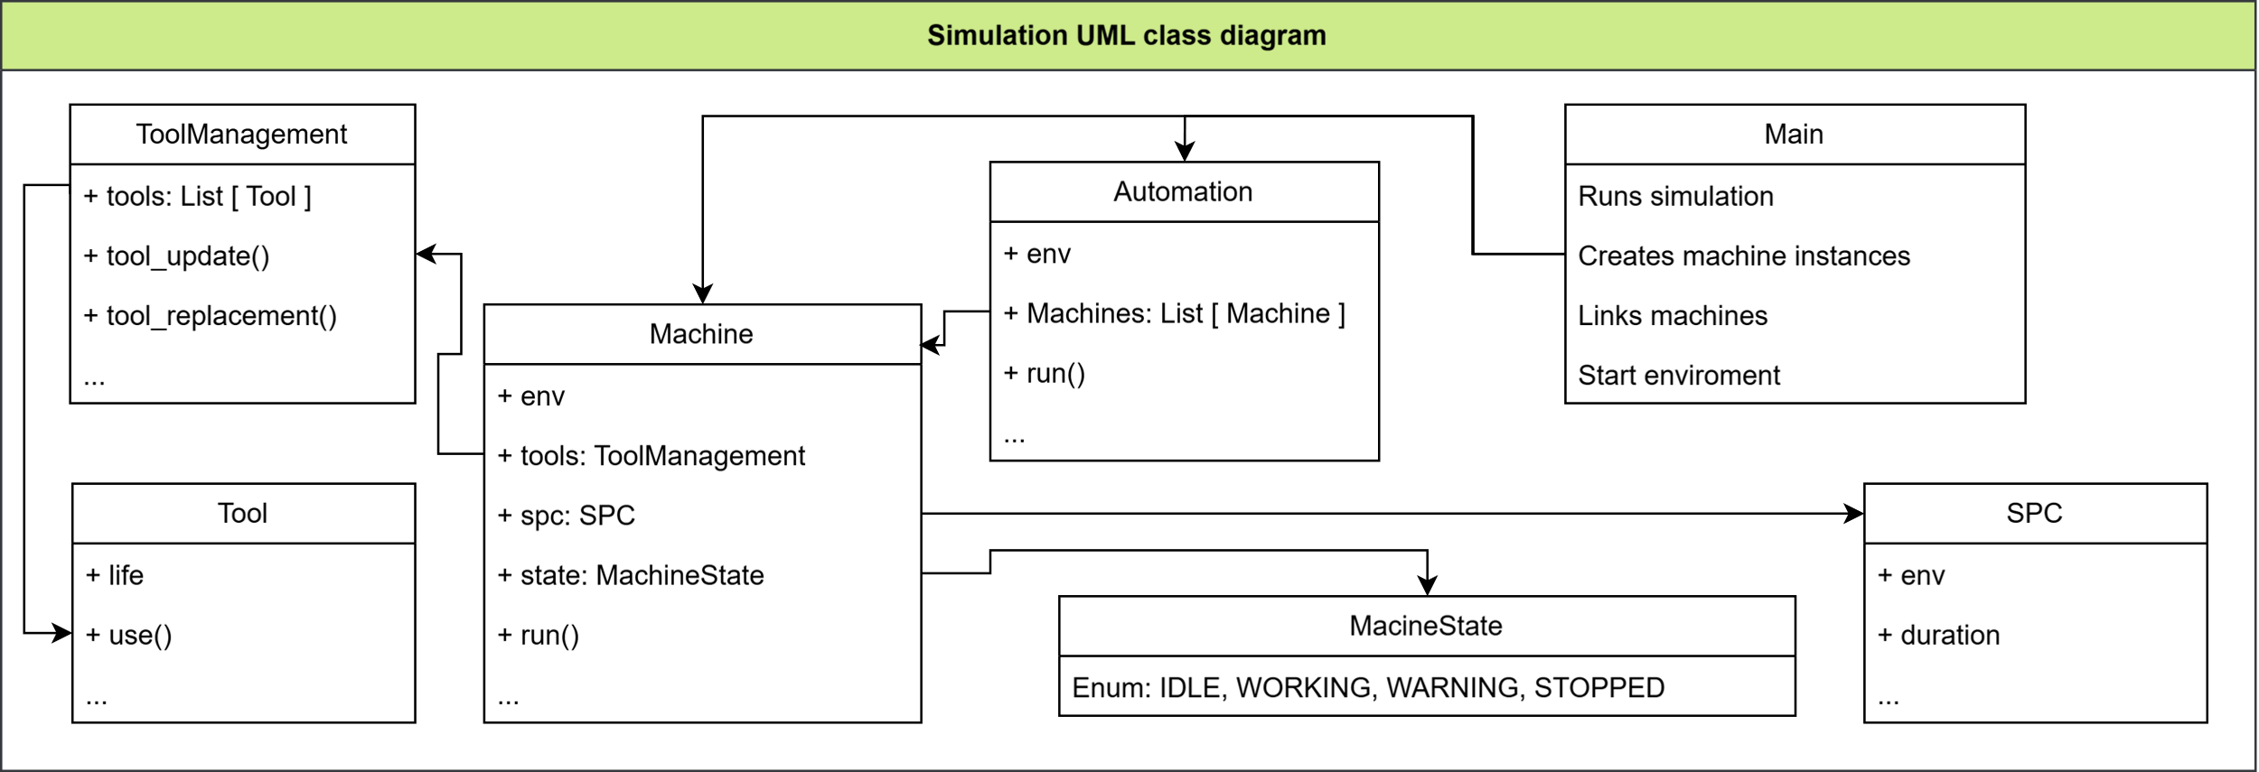
Methodology
A simulation program was developed to generate machine signal data based on Scania's current signal structure and historical patterns.
The simulation replicates only the tracked signals, limiting completeness but ensuring realistic data shape.
Since the data is synthetic and structured, no imputation or normalization was required in preprocessing.
The generated sequences were transformed into time-series inputs for machine learning models.
Notes:
simulation needed due to scada level data is temporary (mostly 1 day or max 1 week) manufacturing execution system MES contains data is not useful for traingn the models this data used for simulations configuration together with field studies.

Slide 6
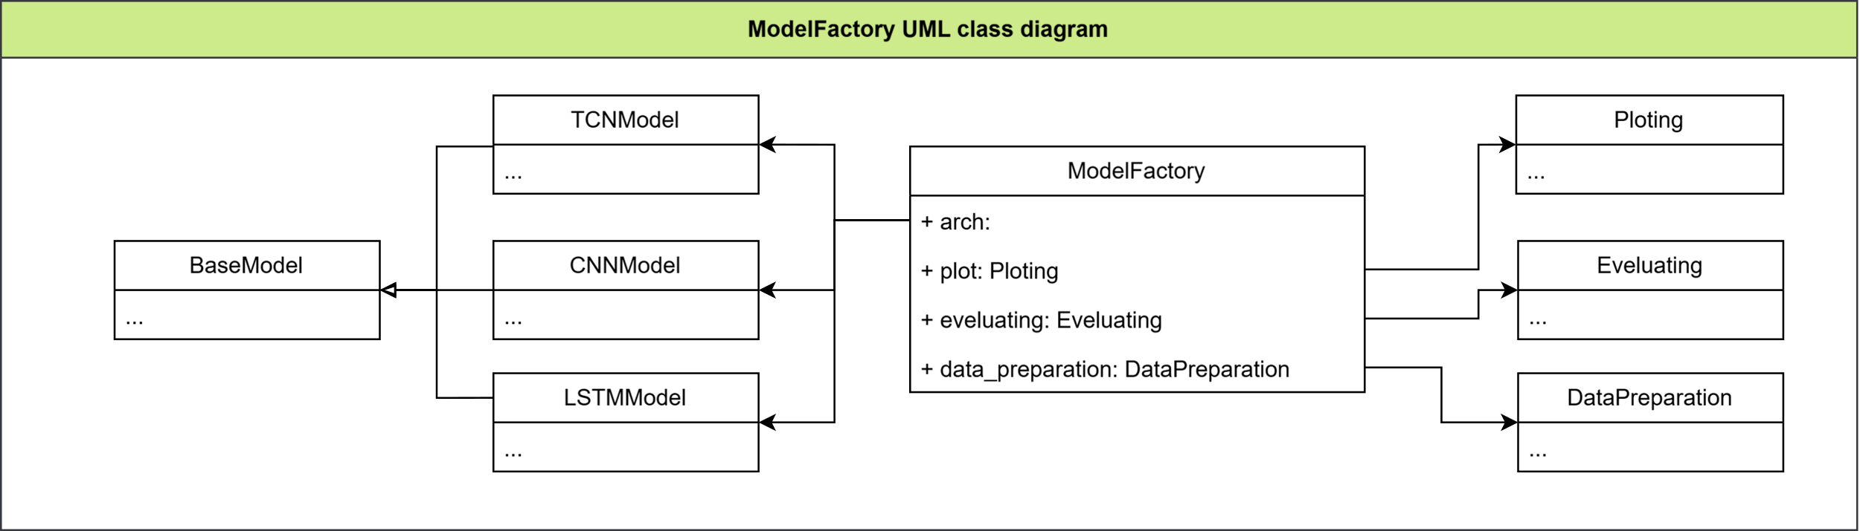
Architecture
TCN (Temporal Convolutional Network)
Captures long-range temporal patterns using dilated causal convolutions.
Well-suited for fixed-length sequences and multi-label forecasting.
CNN (Convolutional Neural Network)
Learns spatial patterns across time steps using convolution filters.
Effective at capturing localized signal features like sudden changes or cycles.
LSTM (Long Short-Term Memory)
Designed to learn long-term dependencies in sequential data.
Handles variable-length input and internal state over time steps.
Notes:
In recent years, research in smart maintenance has shifted from using CNNs to TCNs, especially over the last 5–6 years.
This shift reflects a growing need for models that capture long-term dependencies in time-series data more effectively.
TCN was selected because it supports parallel training, uses dilated causal convolutions, and handles long-range patterns better than standard CNNs.
CNN was included for its strength in capturing short-term temporal features and its efficiency in training.
LSTM was chosen due to its ability to maintain internal memory, making it suitable for modeling sequential dependencies across time.
Together, these models offer a range of capabilities to compare performance in predictive maintenance for time-dependent signals.

Slide 7
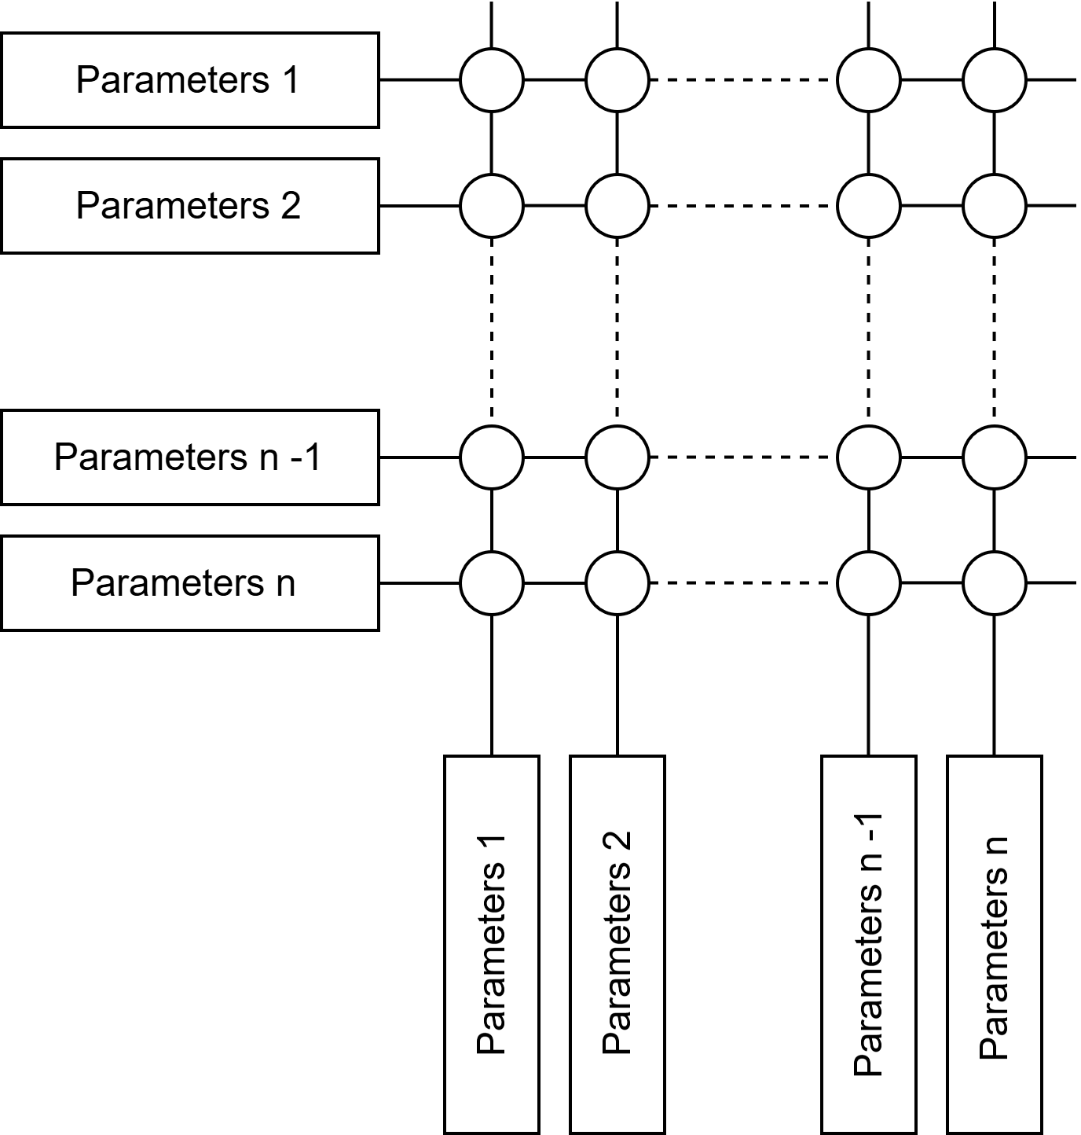
Optimization
Grid search was used to explore different hyperparameter configurations for each model.
All models were trained using the same 3-month training set and validated on the same validations data.
Due to architectural differences, each model required its own tailored search space
While computationally expensive, this approach revealed both optimal settings and deeper insights into input data characteristics.
Notes:
3 mounts data splite to 3 part 70% for train 15% for validating and 15% for testing

Slide 8
Optimization
Notes:
The best-performing models are selected based on three metrics: macro F1, micro F1, and Hamming score.
These metrics are important because this is a multi-label classification problem—each model makes multiple binary decisions per time step (e.g., tool change or quality check for each machine).
Micro F1 aggregates all true positives, false positives, and false negatives across all labels. It gives a more balanced view of overall accuracy, especially when labels are imbalanced.
Macro F1, on the other hand, calculates the F1 score per label and averages them equally. This helps detect if the model performs poorly on certain labels that might otherwise be hidden in the micro average.
Hamming score (or 1 - Hamming loss) measures the fraction of correctly predicted labels per sample, providing insight into how well the model performs on full prediction vectors.
these are the hyper mparameters for each models top 10 archtecture

Slide 9
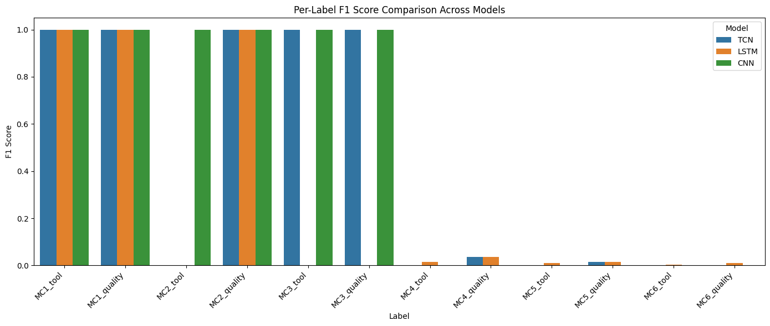
Results
Notes:
after selecting best performacen parameters all three models tested on test set which non of models see before due to validatoin set in between there are minimal rig for future leakage in the models. shown in test result. later on there are a continous learnig test conducted for tath 1 year data split for 3 months trainng and testing for gather base line and restof of data sppllit on 10 day bathces and every batch split on 90 % train and 10% test set internaly trained models continous traind that 90 % data and tested and persformance is saved after test score the models tarined with 10% teat data fram bach befor and 909% of next bathch with this seting result is in some what conservative for not overestimate the models performance. tabel below show the result of this test on every label. as expected TCN and LSTM how some generalizations on labels dow strean and realative best performacen is CNN.

Slide 10
The results do not clearly indicate a single best-performing model across all machines.
For Machine 1, F1 scores were similar across models, but performance diverged further along the line.
As task frequency decreased due to internal dependencies, model performance also declined, particularly for downstream machines.
The last machine showed weak results for all models, with only LSTM showing signs of learning.
Conclusion

Slide 11
Extend from a single-model to a multi-model system, with specialized models per task (e.g., tool change, quality check).
Explore machine-specific models, each tailored and optimized for the behavior of its corresponding CNC machine.
Use Graph Neural Networks (GNNs) to model task dependencies across machines in the production line.
Investigate Reinforcement Learning (RL) to dynamically schedule operator tasks using throughput-based reward signals.
Future Work

Slide 12
?
Thank you for your attention.
I look forward to your questions and feedback.
Q & A

